Slide 1
Intermediate Coding Week 12
Binary Search the Answer and Big O Notation

Slide 2
Big O Notation
What you need to know

Slide 3
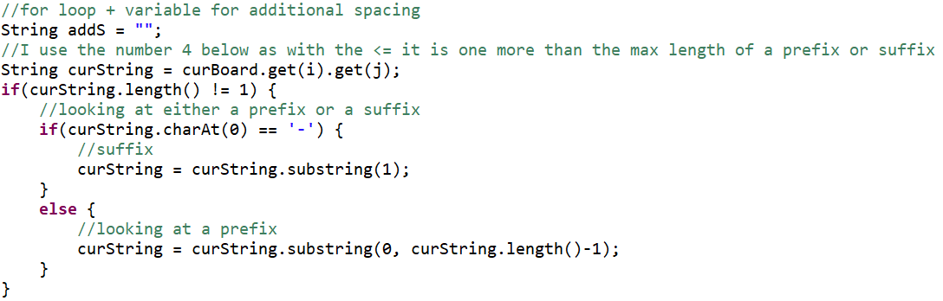
Big O Fundamentals
Big O is a way of measuring the rough number of operations a program takes
Big O is written like such: - O(_)
In general, singular blocks of code are O(1)
For example, this is O(1): (I know, it’s very confusing)

Slide 4


Big O Fundamentals (Continued)
This is O(N)
O($N^{2})$
This is really important for competitive coding, as it helps you know if your program will run under time

Slide 5
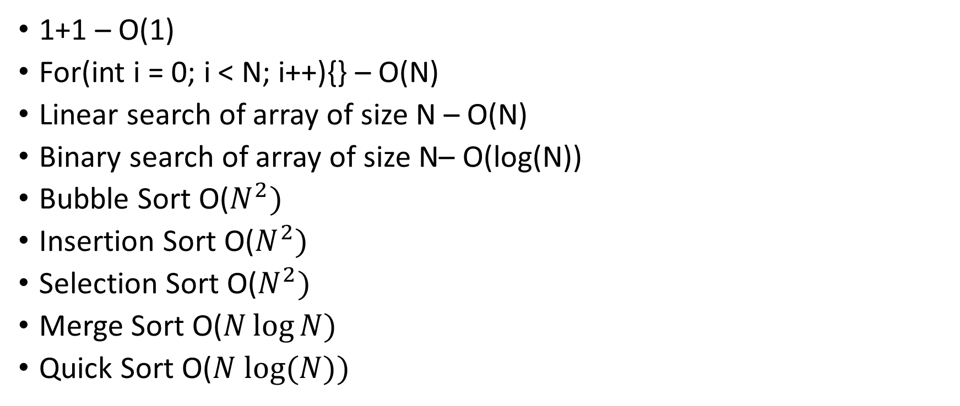
Big O examples
1+1 – O(1)
For(int i = 0; i < N; i++){} – O(N)
Linear search of array of size N – O(N)
Binary search of array of size N– O(log(N))
Bubble Sort O($N^{2})$
Insertion Sort O($N^{2})$
Selection Sort O($N^{2})$
Merge Sort O($N\log{N})$
Quick Sort O($N log⁡(N))$

Slide 6

Searching review

Slide 7
Linear search
A type of search which examines each element from start to finish.
Linear search is also sometimes known as sequential search.
Linear search can be performed on both sorted and unsorted arrays.
Example: Searching the array below for the value 42:
index | 0 | 1 | 2 | 3 | 4 | 5 | 6 | 7 | 8 | 9 | 10 | 11 | 12 | 13 | 14 | 15 | 16
value | -4 | 2 | 7 | 10 | 15 | 20 | 22 | 25 | 30 | 36 | 42 | 50 | 56 | 68 | 85 | 92 | 103
Notes:
A linear search will start at the beginning of the array (index 0) and then look at each value in the array after the other, sequentially, until it finds the value it is looking for. (It will examine index 0, index 1, index 2, etc.)
Notice that the array above is sorted. Could we take advantage of this?
Linear search must consider every single element until it finds the value being searched for. This takes a long time for arrays with lots of elements!

Slide 8
Binary Search, explained
You are going to use two pointers. The value you are searching for is always going to be between those two pointers.
One pointer will start out at the start of the array and one will start out at the end.
In the example below, we are searching for 42.
index | 0 | 1 | 2 | 3 | 4 | 5 | 6 | 7 | 8 | 9 | 10 | 11 | 12 | 13 | 14 | 15 | 16
value | -4 | 2 | 7 | 10 | 15 | 20 | 22 | 25 | 30 | 36 | 42 | 50 | 56 | 68 | 85 | 92 | 103
min
max

Slide 9

Some More About Searching

Slide 10
Built-in Java search methods
indexOf() method for strings
Arrays.binarySearch(array, value)

Slide 11
A Question from Last Week
Write a program that counts the number of negative numbers in a sorted array.
(Hint: can you use binary search to help solve this problem?)

Slide 12
Could we take advantage of Binary Search to solve other problems?
Most important feature of binary search: halving the search space every step.
We can apply this principle of binary search to other kinds of search spaces that aren’t arrays!

Slide 13


Search space of binary search
If some condition is true for $x$, it is true for all $y≥x$, and if some condition is false for $x$, it is false for all $y≤x$.
In other words, the search space looks something like this for some condition:
true true true true true false false false
If we are looking for a number $n$ in a sorted array, if $arr\left[i\right]>n$, $arr\left[j\right]>n$ for all $j≥i$, and if $arr\left[i\right]<n$, $arr\left[j\right]<n$ for all $j≤i$.

Slide 14
Example Binary Search the Answer Problem
Find the square root of an integer n without using the Math.sqrt() function.

Slide 15
Generalized Binary Search the Answer problem
Given a function f(x)that is always increasing and a value y, find the maximum x such that f(x) <= y.

Slide 16

Problems

Slide 17

Question 1
The function $f\left(x\right)=x^{3}−9x^{2}+15x−7$ is increasing for all $5≤x≤10.$
Approximate the $x$ such that $f\left(x\right)=0$, where $5≤x≤10$.

Slide 18
Question 2: Competitive Coding
http://www.usaco.org/index.php?page=viewproblem2&cpid=1038

